Slide 1
ID3 Decision Tree
Paris Tian

Slide 2
What I did
Data analyzing.
Shuffle data. Random select 70% for training, remained 30% for testing
Use training data to build ID3 decision tree
Filling data when data is missing.
Report the number of tree nodes
Use testing data to verify ID3 decision tree
Report prediction result
Correct prediction count
Wrong prediction count
Correct percentage
Prune tree
Re-do prediction,
Compare number of tree node before/after pruning
Compare correct percentage before/after pruning

Slide 3
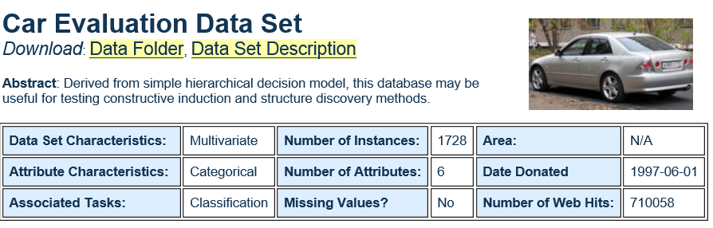
Data Set I used: #1 – Car evaluation
Predict a car is classified into 4 category
‘un-acceptable, acceptable, good, very-good’
6-attributes:
‘buying, maint, doors, persons, lug_boot, safety’
No missing data

Slide 4
Report – Before pruning
How many tree node: 312
Use test data to predict:
Correct prediction count on testing data: 457
Wrong prediction count on testing data: 61
Total prediction count on testing data: 518
Correct percentage on testing data: 88.22393822393822 %
Use training data to predict:
Correct prediction count on training data: 1210
Wrong prediction count on training data: 0
Total prediction count on training data: 1210
Correct percentage on training data: 100.0 %
Correct percentage on whole data: 96.4699074074074 %

Slide 5
Report – After pruning
Number of tree node after prune = 261
Compare before prune
Correct percentage on testing data befor prune: 88.22393822393822 %
Correct percentage on training data befor prune: 100.0 %
Correct percentage on whole data befor prune: 96.4699074074074 %
After prune
Correct percentage on testing data after prune: 93.24324324324324 %
Correct percentage on training data after prune: 94.3801652892562 %
Correct percentage on whole data after prune: 94.03935185185185 %

Slide 6
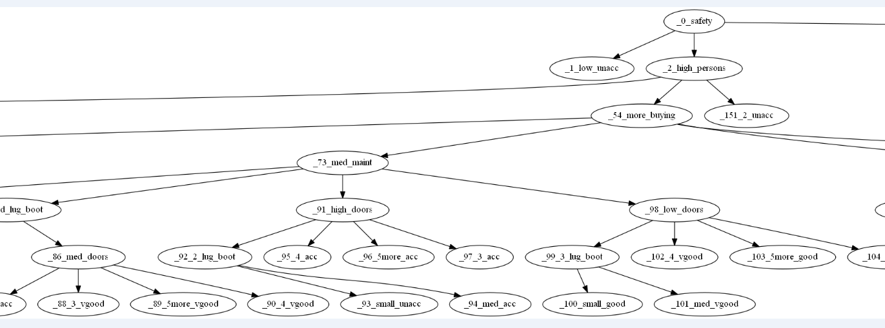
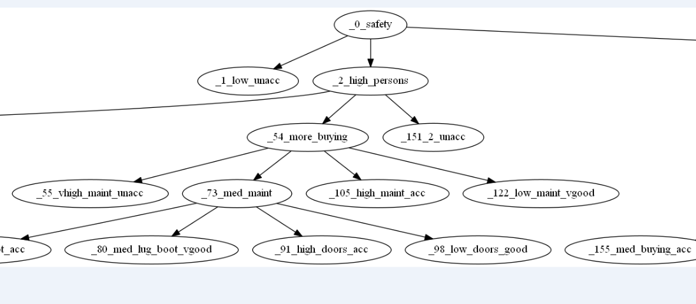

Slide 7
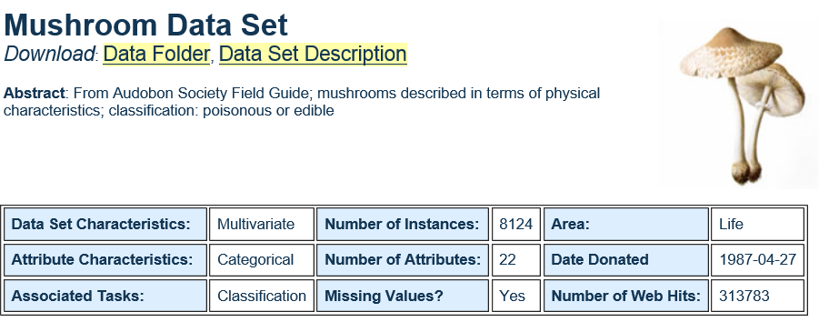
Data Set I used: #2 – Mushroom
Missing Data
Most common among training examples at node n.
Predict edible/poisonous according to 22 attributes.

Slide 8
Report: (No need to prune)
How many tree node: 29
Use test data to predict:
Filling missing data...
Correct prediction count on testing data: 2437
Wrong prediction count on testing data: 0
Total prediction count on testing data: 2437
Correct percentage on testing data: 100.0 %
Use training data to predict:
Correct prediction count on training data: 5687
Wrong prediction count on training data: 0
Total prediction count on training data: 5687
Correct percentage on training data: 100.0 %
Correct percentage on whole data: 100.0 %

Slide 9
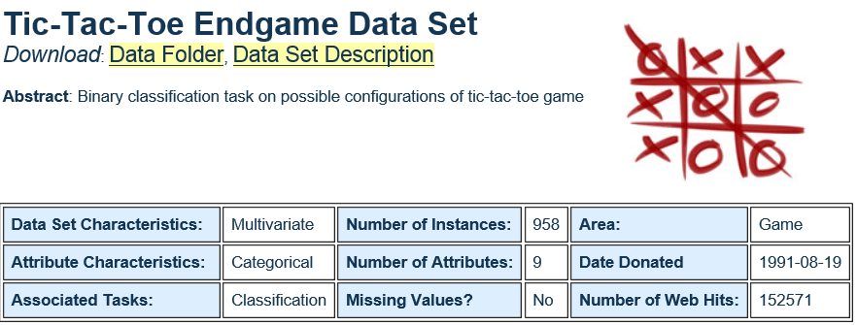
Data Set I used: #3 – Tic-Tac-Toe

Slide 10
Report – Before Pruning
How many tree node: 269
Use test data to predict:
Correct prediction count on testing data: 242
Wrong prediction count on testing data: 45
Total prediction count on testing data: 287
Correct percentage on testing data: 84.3205574912892 %
Use training data to predict
Correct prediction count on training data: 671
Wrong prediction count on training data: 0
Total prediction count on training data: 671
Correct percentage on training data: 100.0 %
Correct percentage on whole data: 96.13778705636743 %

Slide 11
Report – After Pruning
Tree node after prune = 222
Compare before pruning
Correct percentage on testing data before prune: 84.3205574912892 %
Correct percentage on training data before prune: 100.0 %
Correct percentage on whole data before prune: 95.3027139874739%
After pruning
Correct percentage on testing data after prune: 87.8048780487805 %
Correct percentage on training data after prune: 90.31296572280179 %
Correct percentage on whole data after prune: 89.56158663883089 %

Slide 12
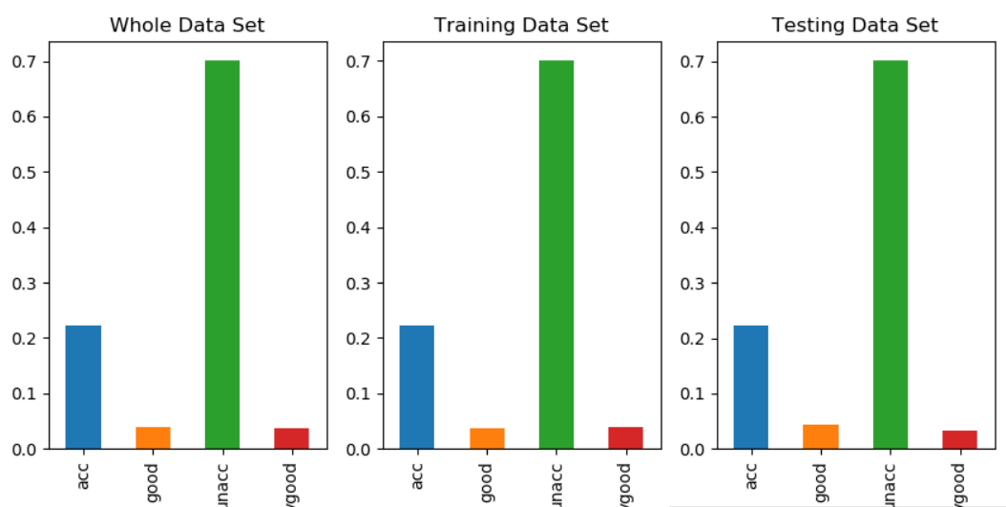
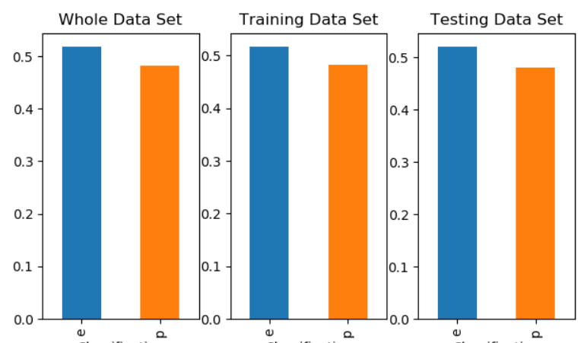
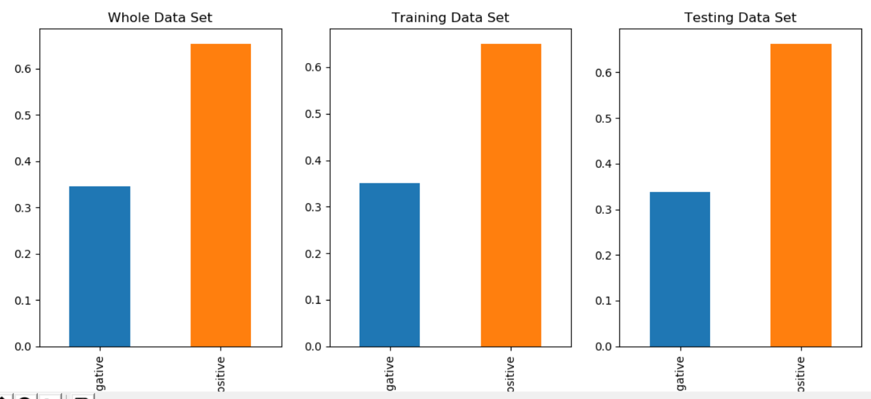
Some thought – When decision tree works?
Car
Balanced distributed data set
Mushroom
Game

Slide 13
Some thought – When decision tree works?
Plenty of training data could tolerate noise
Mushroom
Training data size: 5687
Testing data size: 2437
Car
Training data size: 1210
Testing data size: 518
Game
Training data size: 671
Testing data size: 287

Slide 14
Some thought – When decision tree works?
Limited classification.
The more classifications we have, the decision tree will be bigger and more complicated.
Only deal with discrete input data, and discrete output data.

Slide 15
END

